Slide 1
Chapter-10:
Numbers Matter
Upcode Software
Engineer Team
-2023-

Slide 2
CONTENT
Static and non-static parameters.
Wrapping a primitive.
Autoboxing: blurring the line between primitive and object.
Autoboxing works almost everywhere.
Wrappers have static utility methods too!
Primitive number into a String.
Number formatting.
What about dates ?
What about Calendar Api?
Static import.

Slide 3
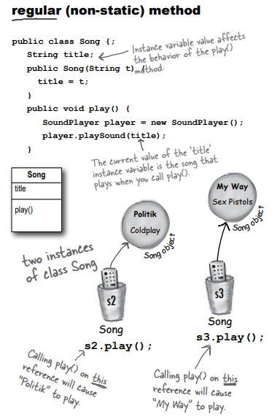
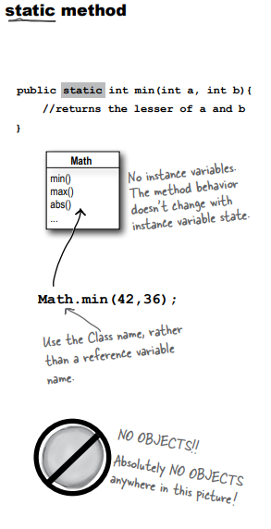
Static and non-static parameters (1/n)
The difference between regular (non-static) and static methods

Slide 4
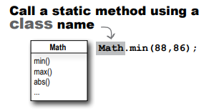
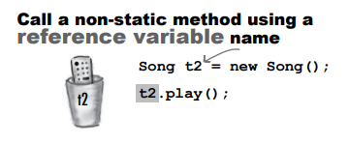
Static and non-static parameters (2/n)

Slide 5
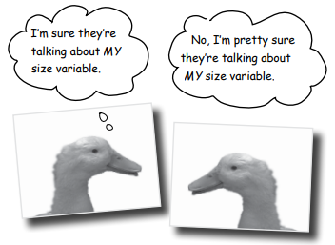
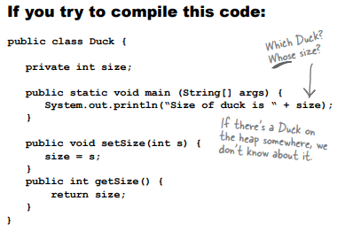
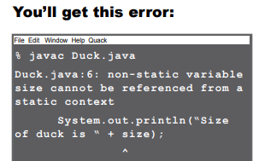
Static and non-static parameters (3/n)
Static methods can’t use non-static (instance) variables!
If you try to use an instance variable from inside a static method, the compiler thinks, “I don’t know which object’s instance variable you’re talking about!”
If you have ten Duck objects on the heap, a static method doesn’t know about any of them.

Slide 6
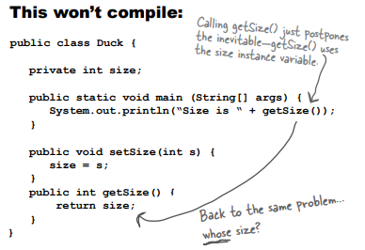
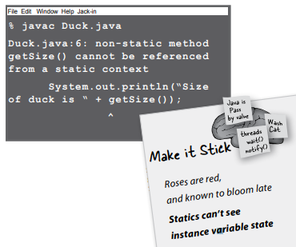
Static and non-static parameters (4/n)
Static methods can’t use non-static methods, either!

Slide 7
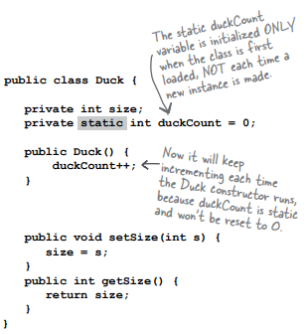
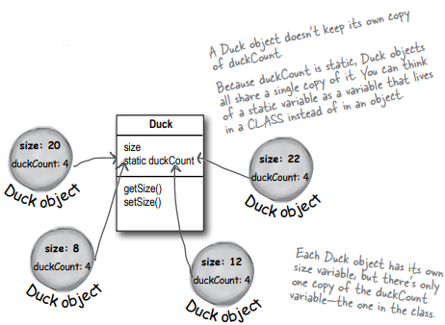
Static and non-static parameters (5/n)
Static variable: value is the same for ALL instances of the class

Slide 8

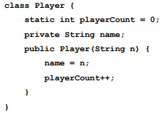
Static and non-static parameters (6/n)
Initializing a static variable.
All static variables in a class are initialized before any object of that class can be created.
Static variables in a class are initialized before any static method of the class runs.

Slide 9
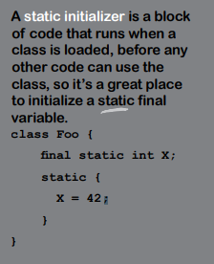
Static and non-static parameters (7/n)
static final variables are constants.
The variable is marked final because PI doesn’t change (as far as Java is concerned).
public static final double PI = 3.141592653589793;

Slide 10
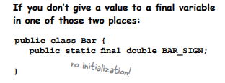
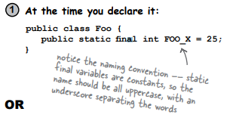
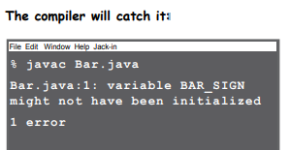
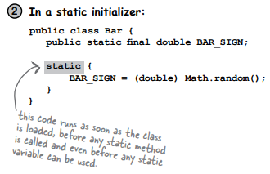
Static and non-static parameters (8/n)
Initialize a final static variable:

Slide 11


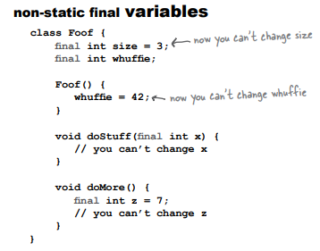
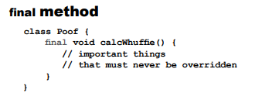
Static and non-static parameters (9/n)
Final isn’t just for static variables...

Slide 12
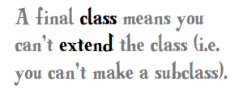


Static and non-static parameters (10/n)

Slide 13
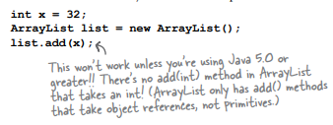
Wrapping a primitive. (1/n)
Sometimes you want to treat a primitive like an object. For example, in all versions of Java prior to 5.0, you cannot put a primitive directly into a collection like ArrayList or HashMap:

Slide 14
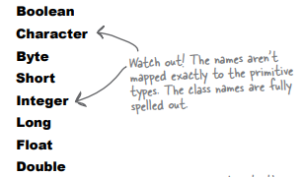
Wrapping a primitive. (2/n)
There’s a wrapper class for every primitive type, and since the wrapper classes are in the java. lang package, you don’t need to import them.
You can recognize wrapper classes because each one is named after the primitive type it wraps, but with the first letter capitalized to follow the class naming convention.

Slide 15
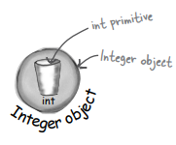
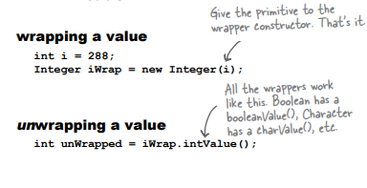
Wrapping a primitive. (3/n)
When you need to treat a primitive like an object, wrap it. If you’re using any version of Java before 5.0, you’ll do this when you need to store a primitive value inside a collection like ArrayList or HashMap.

Slide 16
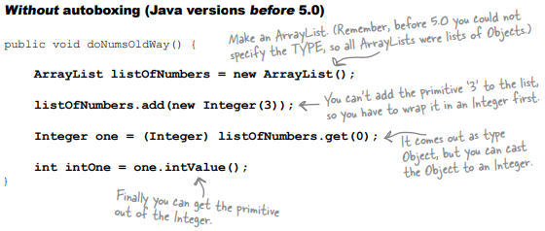
Wrapping a primitive. (4/n)
An ArrayList of primitive ints.

Slide 17
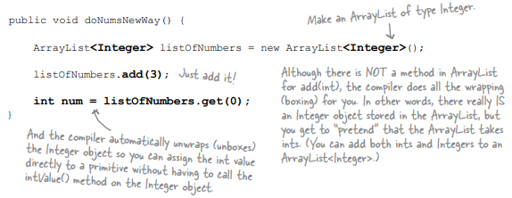
Blurring the line between primitive and object.
The autoboxing feature added to Java 5.0 does the conversion from primitive to wrapper object automatically!

Slide 18
Autoboxing works almost everywhere.
Autoboxing lets you do more than just the obvious wrapping and unwrapping to use primitives in a collection... it also lets you use either a primitive or its wrapper type virtually anywhere one or the other is expected.
Method arguments.
Return values.
Boolean expressions.
Operations on numbers.
Assignments.

Slide 19
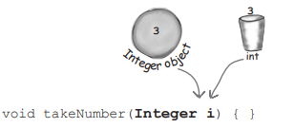
Autoboxing works almost everywhere. (Method )
Method arguments.
If a method takes a wrapper type, you can pass a reference to a wrapper or a primitive of the matching type. And of course the reverse is true—if a method takes a primitive, you can pass in either a compatible primitive or a reference to a wrapper of that primitive type.

Slide 20
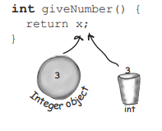
Autoboxing works almost everywhere. (Return)
Return values.
If a method declares a primitive return type, you can return either a compatible primitive or a reference to the wrapper of that primitive type. And if a method declares a wrapper return type, you can return either a reference to the wrapper type or a primitive of the matching type.

Slide 21
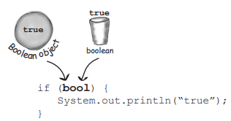
Autoboxing works almost everywhere. (Boolean)
Boolean expressions.
Any place a boolean value is expected, you can use either an expression that evaluates to a boolean (4 > 2), or a primitive boolean, or a reference to a Boolean wrapper.

Slide 22
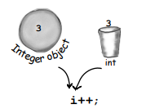
Autoboxing works almost everywhere. (Operations)
Operations on numbers.
This is probably the strangest one—yes, you can now use a wrapper type as an operand in operations where the primitive type is expected. That means you can apply, say, the increment operator against a reference to an Integer object!
But don’t worry—this is just a compiler trick. The language wasn’t modified to make the operators work on objects; the compiler simply converts the object to its primitive type before the operation.
Integer i = new Integer(42); i++;

Slide 23
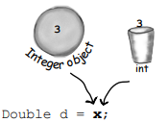
Autoboxing works almost everywhere. (Assignments)
Assignments.
You can assign either a wrapper or primitive to a variable declared as a matching wrapper or primitive. For example, a primitive int variable can be assigned to an Integer reference variable, and vice-versa—a reference to an Integer object can be assigned to a variable declared as an int primitive.

Slide 24
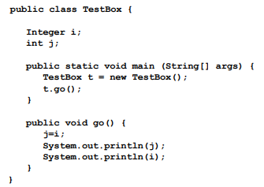

QUESTION ?
Will this code compile? Will it run? If it runs, what will it do?

Slide 25
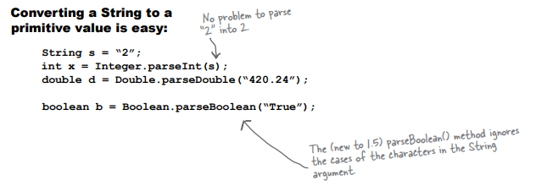
Wrappers have static utility methods too! (1/n)
Besides acting like a normal class, the wrappers have a bunch of really useful static methods.
The parse methods take a String and give you back a primitive value.

Slide 26
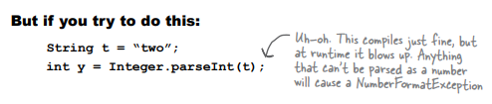
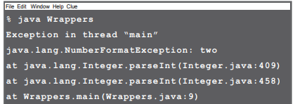
Wrappers have static utility methods too! (2/n)
Every method or constructor that parses a String can throw a NumberFormatException.
It’s a runtime exception, so you don’t have to handle or declare it.

Slide 27



Primitive number into a String.
There are several ways to turn a number into a String.
The easiest is to simply concatenate the number to an existing String

Slide 28
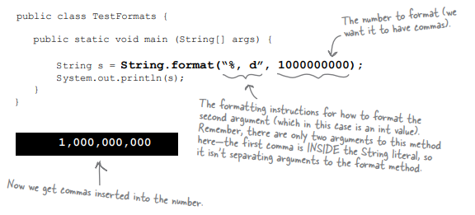
Number formatting. (1/n)
Formatting a number to use commas.

Slide 29

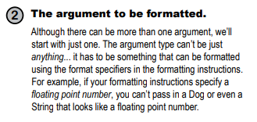
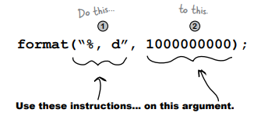
Number formatting. (2/n)
Formatting deconstructed…
At the most basic level, formatting consists of two main parts (there is more, but we’ll start with this to keep it cleaner):

Slide 30
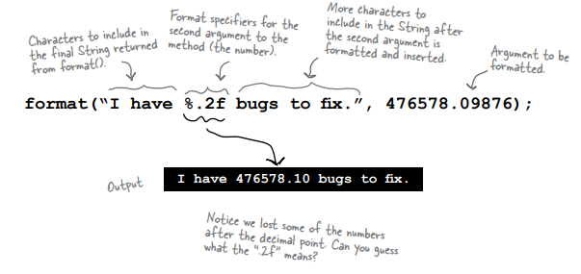
Number formatting. (3/n)
The percent (%) says, “insert argument here” (and format it using these instructions).
The “%” sign tells the formatter to insert the other method argument (the second argument to format(), the number) here, AND format it using the “.2f” characters after the percent sign

Slide 31
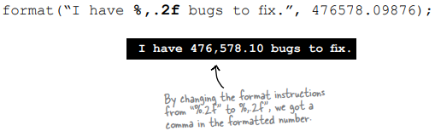
Number formatting. (4/n)
Adding a comma.

Slide 32
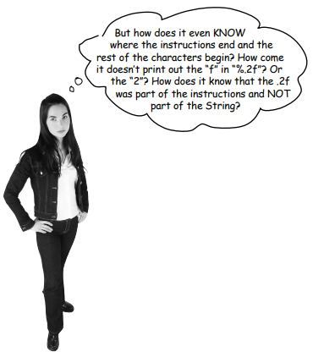
Number formatting. (5/n)
The format String uses its own little language syntax.
You obviously can’t put just anything after the “%” sign. The syntax for what goes after the percent sign follows very specific rules, and describes how to format the argument that gets inserted at that point in the result (formatted) String.
%, d means “insert commas and format the number as a decimal integer.”
%.2f means “format the number as a floating point with a precision of two decimal places.”
%,.2f means “insert commas and format the number as a floating point with a precision of two decimal places.”

Slide 33
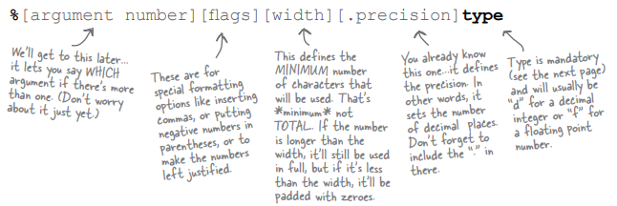
Number formatting. (6/n)
The format specifier.
A format specifier can have up to five different parts (not including the “%”). Everything in brackets [ ] below is optional, so only the percent (%) and the type are required. But the order is also mandatory, so any parts you DO use must go in this order.

Slide 34


What about dates? (1/n)
The main difference between number and date formatting is that date formats use a two-character type that starts with “t” (as opposed to the single character “f” or “d”, for example).
The examples below should give you a good idea of how it works:

Slide 35
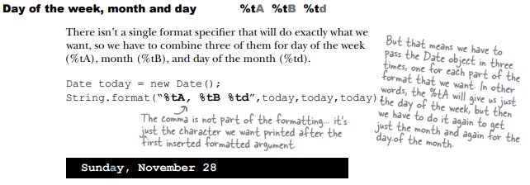
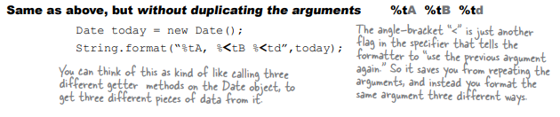
What about dates? (2/n)

Slide 36
What about dates? (3/n)
Moving backward and forward in time.
For a time-stamp of “now”, use Date. But for everything else, use Calendar.
The Date class is still great for getting a “time stamp”—an object that represents the current date and time, so use it when you want to say, “give me NOW”.
Use java.util.Calendar for your date manipulation
More interesting, though, is that the kind of calendar you get back will be appropriate for your locale. Much of the world uses the Gregorian calendar, but if you’re in an area that doesn’t use a Gregorian calendar you can get Java libraries to handle other calendars such as Buddhist, or Islamic or Japanese.

Slide 37
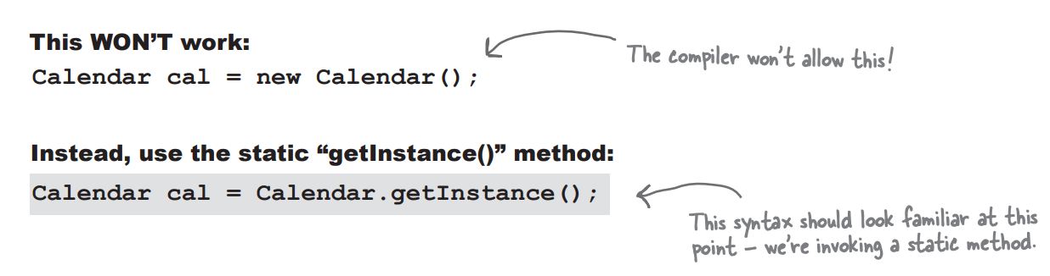
What about Calendar Api ? (1/n)
Getting an object that extends Calendar.
How in the world do you get an “instance” of an abstract class? Well you don’t of course, this won’t work:

Slide 38
What about Calendar Api ? (2/n)
Working with Calendar objects.
Fields hold state - A Calendar object has many fields that are used to represent aspects of its ultimate state, its date and time. For instance, you can get and set a Calendar’s year or month.
Dates and Times can be incremented - The Calendar class has methods that allow you to add and subtract values from various fields, for example “add one to the month”, or “subtract three years”.
Dates and Times can be represented in milliseconds - The Calendar class lets you convert your dates into and out of a millisecond representation.

Slide 39
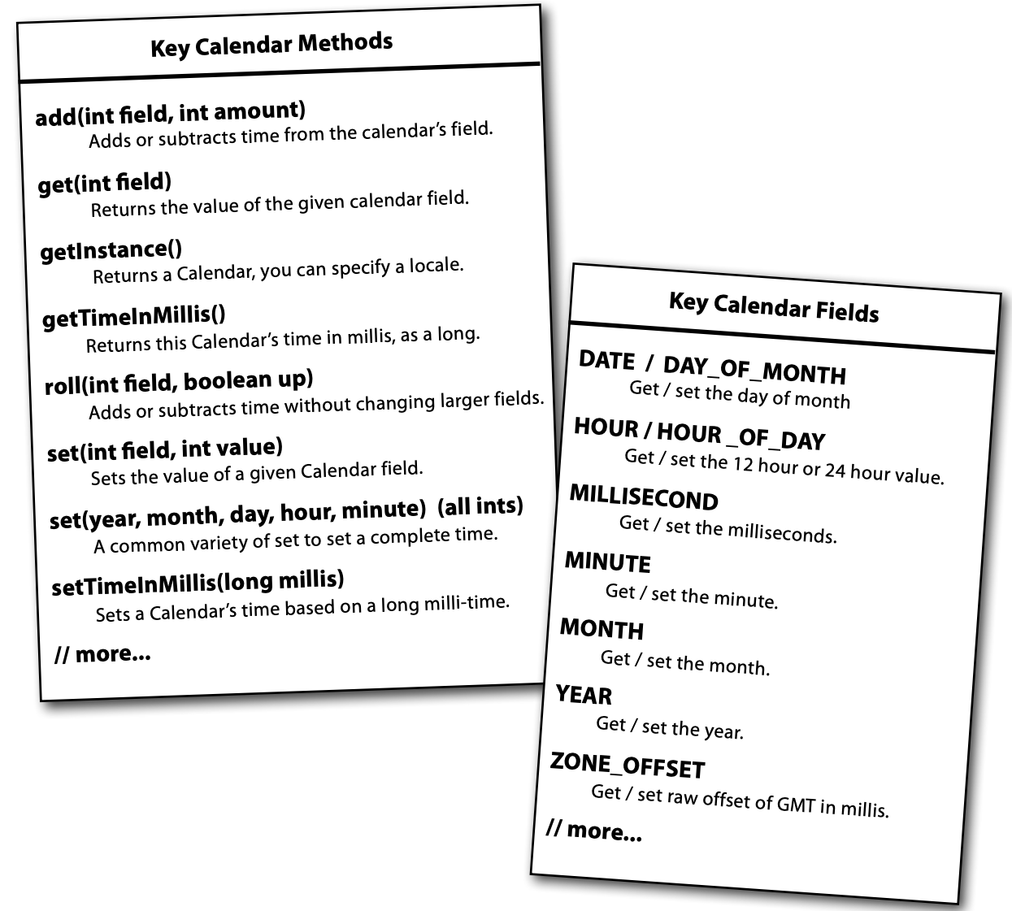
What about Calendar Api ? (3/n)
Highlights of the Calendar API.

Slide 40
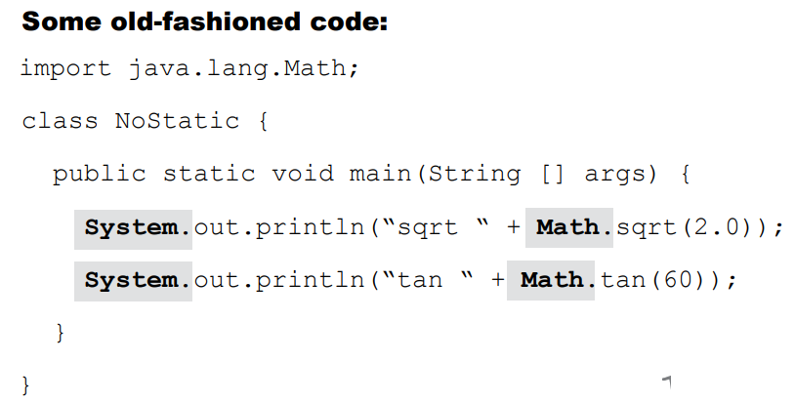
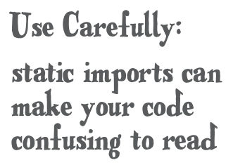
Static import (1/n)
Even more Statics!... static imports.
New to Java 5.0... a real mixed blessing. Some people love this idea, some people hate it. Static imports exist only to save you some typing. If you hate to type, you might just like this feature. The downside to static imports is that - if you’re not careful - using them can make your code a lot harder to read.

Slide 41
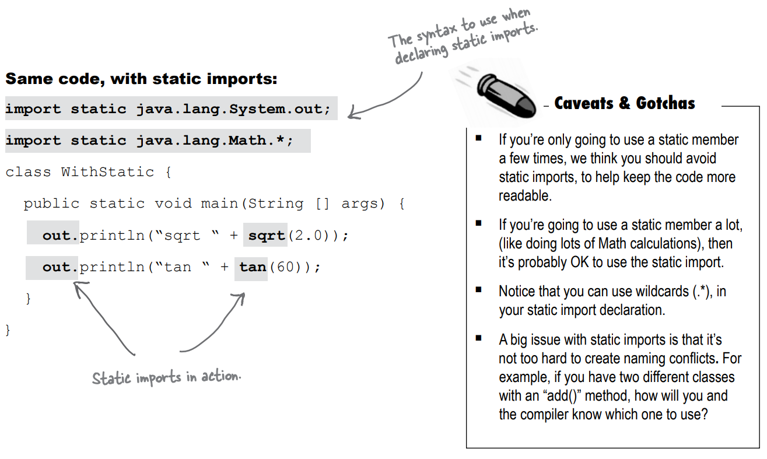
Static import (2/n)

Slide 42
Reference
Head First book (page 273- 314)

Slide 43
Thank you!
Presented by Jahongir Sherjonov
(jakhongirsherjonov@gmail.com)

